Slide 1




Java Application Architecture at Ford
@team Java Center of Excellence (JCOE)
@presenters Julie Burnard & Marvin Toll
Page <number>
Page <number>

Slide 2
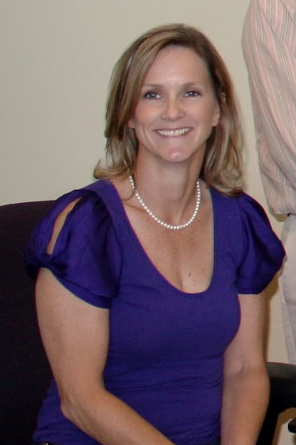
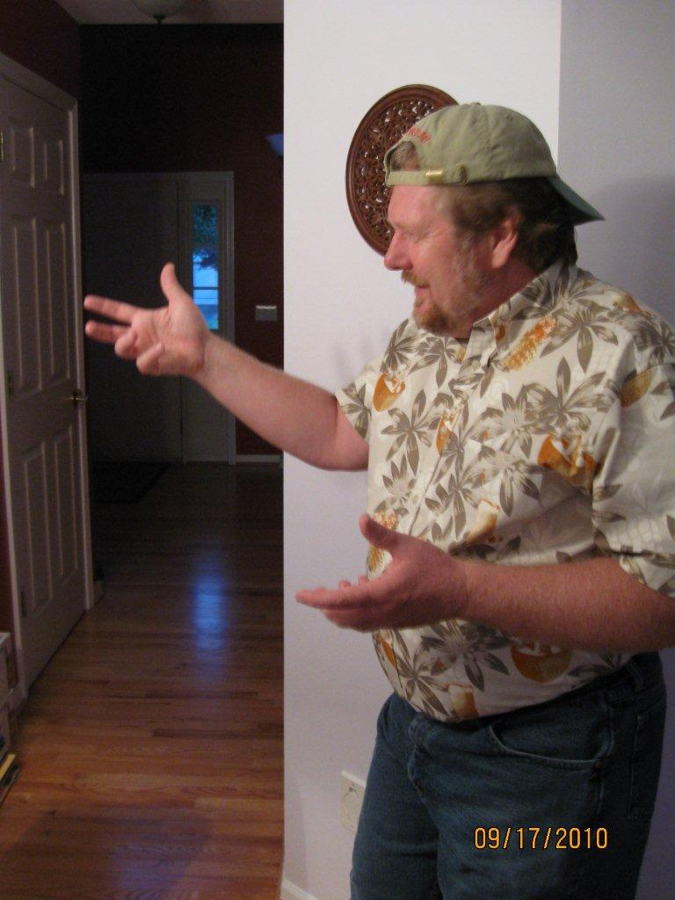
Page <number>
Page <number>

Slide 3
The ‘Agilization’ of Ford Java
Enterprise Application Architecture
2002 – Ford Java Frameworks (FJF)
2006 – JcriBase Framework
2007 – CDF Toolset Ref. App
2008 – “Core” Frameworks
2009 – JAB Reference Application
2010a – JADAF Training Class
2010b – Architecture/Design Maturity
  Application Architecture (one page)
  Ford Java Patterns (Wiki Site)
Never reached General Availability (GA) status
Page <number>
Page <number>

Slide 4
Proven Effectiveness Principles
Embedded consultants…
Framework abstractions (i.e. ‘core’ frameworks)…
Reference implementations…
Hands-on face-to-face training (mentoring/coaching) classes…
Patterns that include working software…
are an effective way to transmit Architecture/Design ideas
Page <number>

Slide 5
Historical Diagram References
Over the past 8 years, the Ford Application Architecture diagram has had many different personalities…
Page <number>

Slide 6
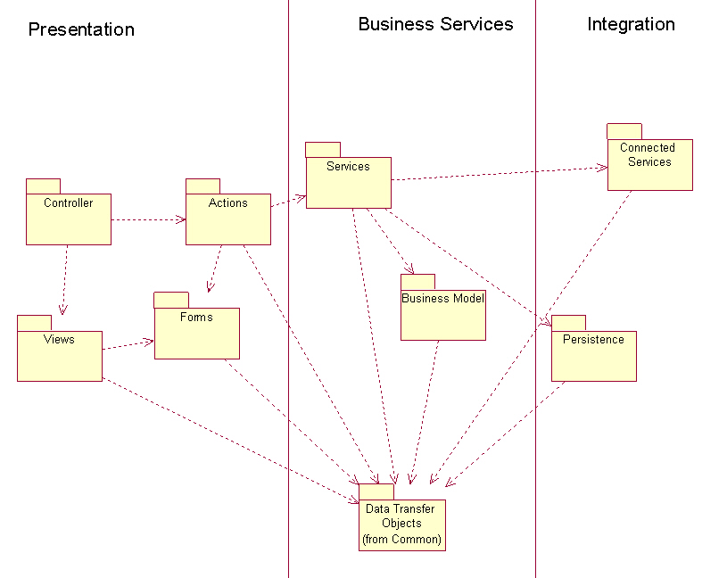
Page <number>
Page <number>

Slide 7
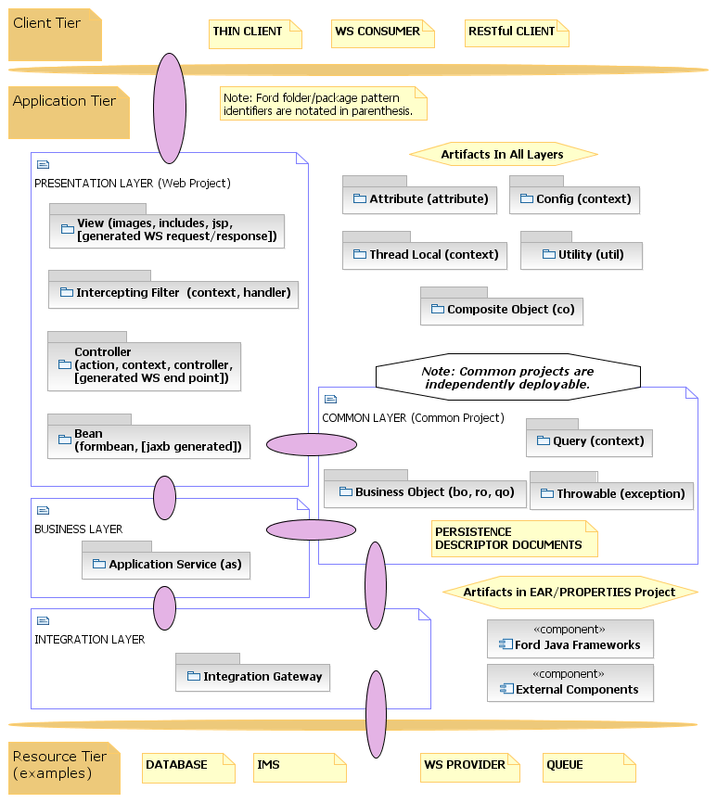
Page <number>
Page <number>

Slide 8
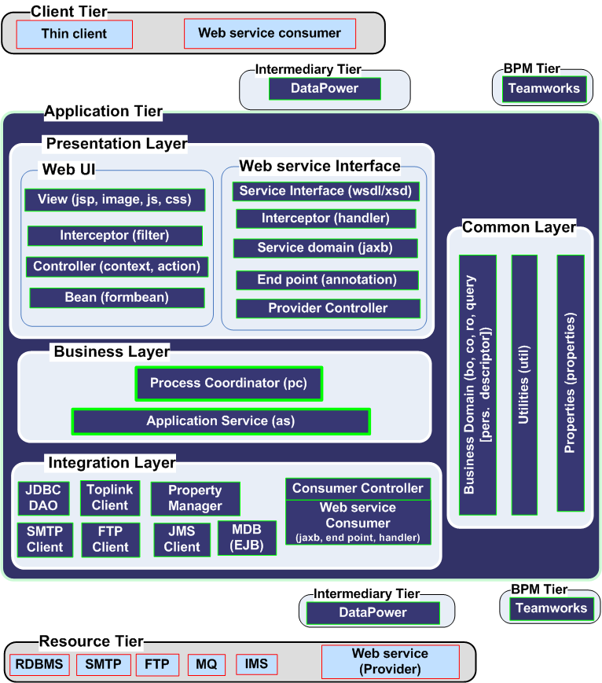
Page <number>
Page <number>

Slide 9
Current View
And now…
Page <number>

Slide 10
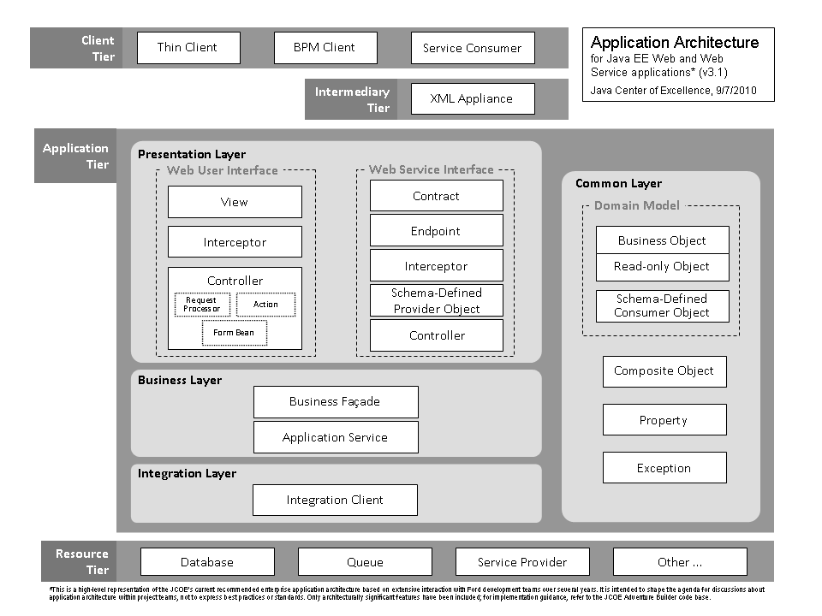
Page <number>
Page <number>

Slide 11
Three Physical Tiers
Client Tier
Application Tier
Resource Tier
Page <number>
Page <number>

Slide 12
Three Physical Tiers
Client Tier
  Responsible for requesting data from the Application Tier then formatting and optionally displaying the result
  Examples:
    Browser
    Web Service Consumer
Page <number>
Page <number>

Slide 13
Three Physical Tiers
Application Tier
  At Ford, the Application Tier resides in a single JVM and is composed of 4 Logical Layers
  More detail on the logical layers in a minute…
Page <number>
Page <number>

Slide 14
Three Physical Tiers
Resource Tier
  Comprised of external resource(s) the Application Tier interfaces with in order to provide business functionality
  Examples:
    Database
    Web Service
    Queue
    eHub
    FTP Server
    IMS
    SMTP Server
    Etc…
Page <number>
Page <number>

Slide 15
Application Tier - Logical Layers
Presentation Layer
  Boundary layer for Client Tier interaction
Business Layer
  Internal layer to provide business functionality and maximize reuse
Integration Layer
  Boundary layer for Resource Tier interaction
Common Layer
  Artifacts accessible by all other layers
Page <number>
Page <number>

Slide 16
Application Tier - Logical Layers – Key Concepts
Presentation
  Actions are only responsible for navigation
  Form Beans encapsulate Domain Objects
  Form Beans interact with Business Layer by calling methods on a Business Façade
  Domain Objects are passed to/from the FormBean and Business Facade
Business
  Business Façade interacts with Application Services
  Application Services are technology focused
    PersistenceAS & WscConsumerAS
Integration
  Boundary layer for Resource Tier interaction
Common
  Domain Objects belong to the Common Layer because they can be accessed by all other Layers
  Common Layer components should not have dependencies on the Business or Presentation Layer
Page <number>
Page <number>

Slide 17
JAB Application Architecture
How does all this relate to the JCOE Adventure Builder (JAB) application?
First let’s review the functionality of JAB…
Page <number>

Slide 18
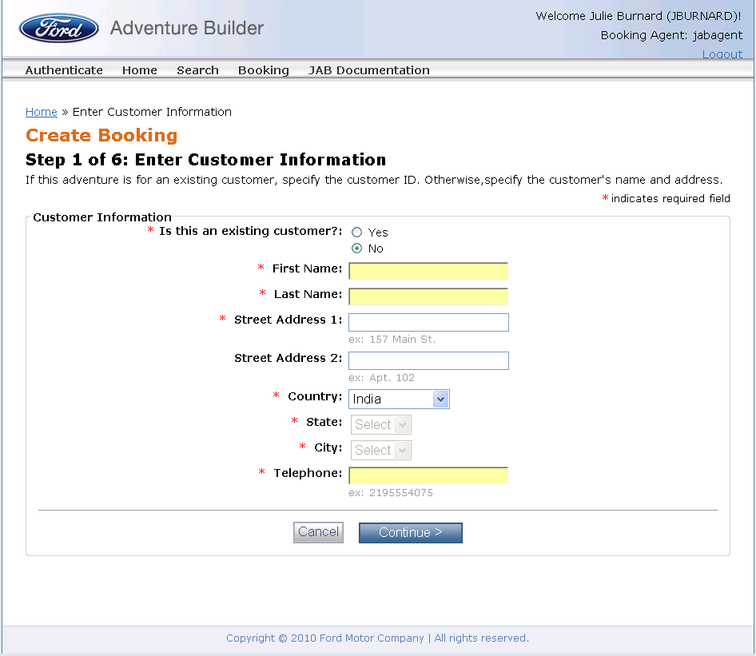

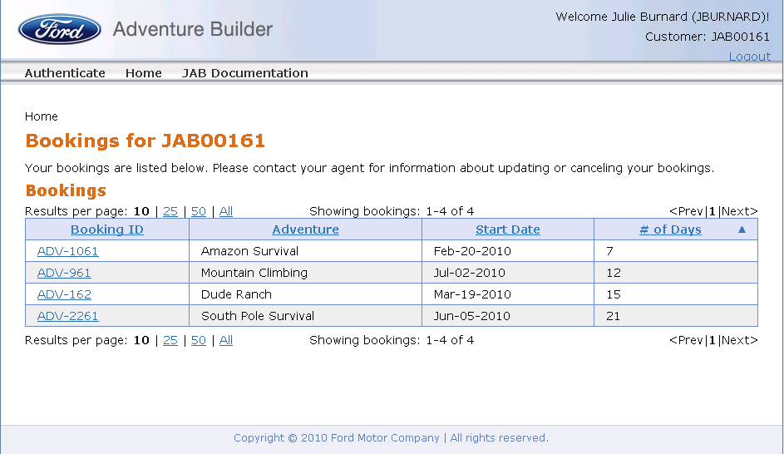



JCOE Adventure Builder (JAB)
The JAB Story:
An agent at small agency books travel adventures.
2 – Agent books or updates an Adventure.
Use Case: Manage Booking
The Agent
1 - Customer phones the Agent.
3 – Customer views booked Adventures.
Many Customers
Use Case:
View Customer Booking
Page <number>
Page <number>
Notes:
Very simple application used to demonstrate many of the recommend implementation patterns for web application development
Small Travel agency – Only one agent that is responsible for managing Customer Bookings
Two types of users – Agent and Customers
Customers use the old fashioned method of calling the agent via telephone to book their Adventure
Once an Adventure is booked, a customer can view/print their bookings

Slide 19
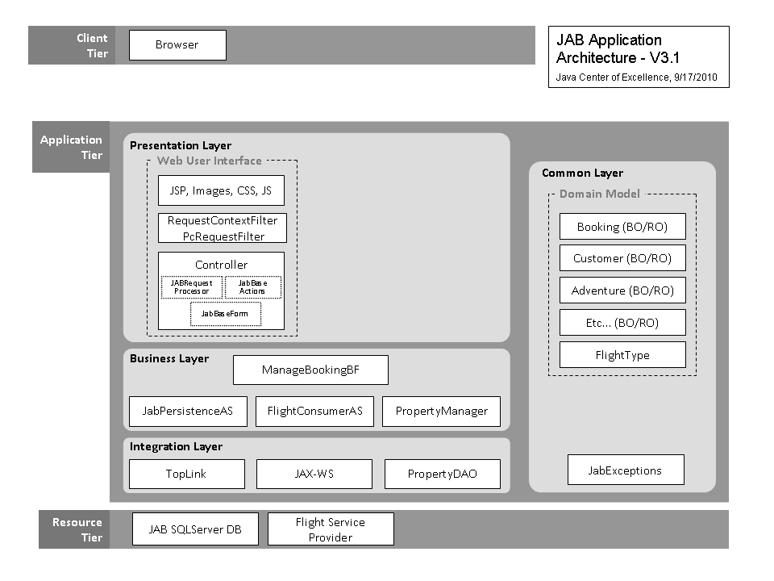
Page <number>

Slide 20
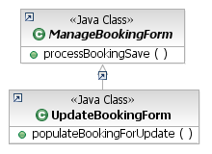


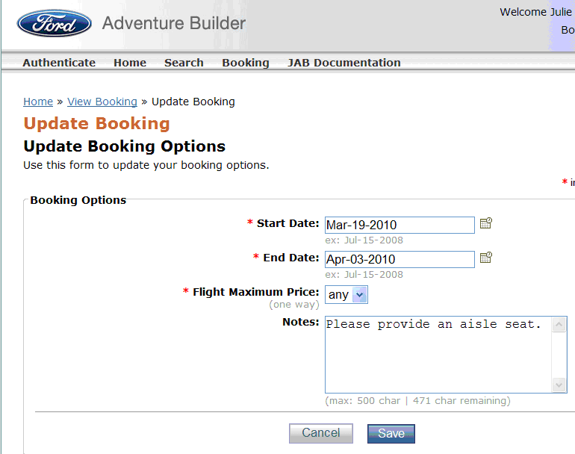

Presentation Layer (UpdateBooking)
Next Action
or Tile
clearFormsFromSession()
forward to
next Action or Tile
processBookingSave()
forward to /updateOptionsPre.do
populateBookingForUpdate()
form action=
/updateOptionsPost
forward to
/tile.updateBooking
Page <number>
Page <number>

Slide 21
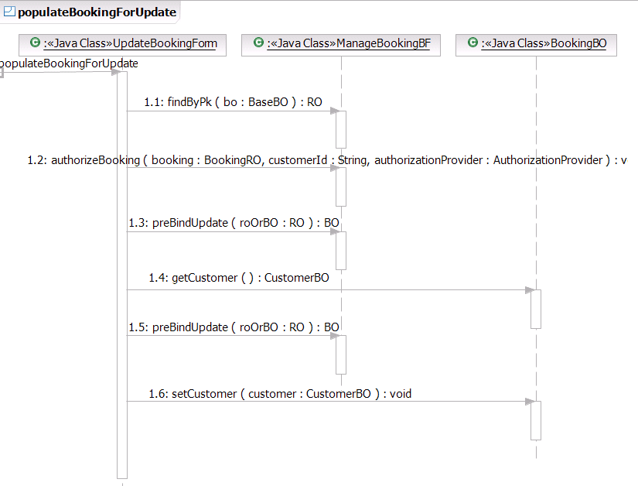
Presentation Layer / Business Layer Interaction
Page <number>

Slide 22
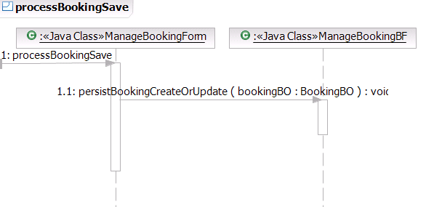
Presentation Layer / Business Layer Interaction
Page <number>

Slide 23
Application Architecture ‘Core’ Frameworks
Emerged by working ‘hands-on’ with multiple project teams over several years
Instantiate Ford application architecture in ‘working software’
Promote design consistency and implementation quality within and across applications
Avoid duplicate code
Enable immediate distribution of improvements
Page <number>

Slide 24
2002-2006
Mostly “Utility” Frameworks
Struts
PropertyManager
RequestContext
HttpPoster
Apache Commons
JAXB
FTP
Logging
Exception
Crypt
EAA Security
LDAP
UnitTest
Credentials
Utils
TimedRequest
Presentation
WSHandlers
DisplayTag
iText
2002-2010 Integration Focused Frameworks
eSpoke
Toplink
ORConn
IMSConnector
RecordMapper
NICConn
WebFocusConn
2007-2010
Application Architecture
Frameworks
2009-2010
Business Functionality
Frameworks
Persistence
PersistenceCore
BO/RO
Internationalization
Process Control
StrutsCore
WsCore
Data Purge
User Profile
ReportGen
Key:
Internally Developed
OSS or Based on OSS
Page <number>
Page <number>

Slide 25
‘Core’ Framework Benefits (ELLPA)
E – Exceptions contextualized for Ford
L – Logging insight into internal framework processing
L – Limited (‘just enough’) API
P – Pattern enforcement
A – Application architecture/design guidance (JCOE to self-organizing project teams)
Page <number>
Page <number>

Slide 26
Persistence Technology
Unique Lines Of Non-Presentation Transactional Code | DAO | DAO Test | AS | AS Test | Total
JDBC (compare-coded in 2005) | 61 | 9 | 12 | 11 | 93
Jcri (1st-quarter 2006) | 4 | 6 | 12 | 11 | 33
MyCore (3rd-qtr. 2007) | 0 | 0 | 12 | 11 | 23
PersistenceCore (2009) | 0 | 0 | 0 | 12 | 12
Create, Read, Update, Delete, and Associate (CRUDA) Against Representative
WIQS Application Table.
Page <number>
Page <number>

Slide 27
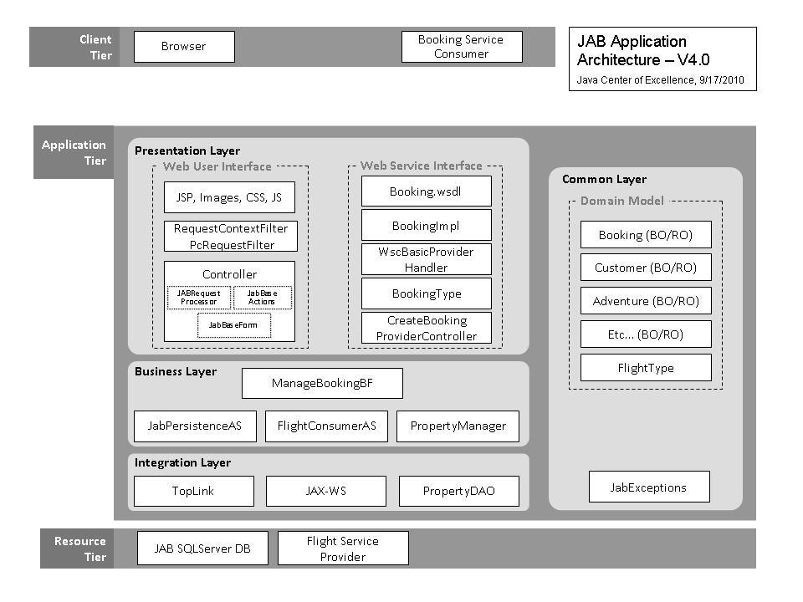
Page <number>

Slide 28

WsCore
ITCore
StrutsCore
Persistence
&
Persistence
Core
WsCore
ITCore
Page <number>

Slide 29
Packaging View
JCOEAdventureBuilderEAR
JCOEAdventureBuilderStrutsWeb
JCOEAdventureBuilderServiceWeb
JAB 4.0
JCOEAdventureBuilderBusiness
JCOEAdventureBuilderCommon
JCOEAdventureBuilderProperties
Page <number>

Slide 30

Deployment View
Client Tier
Application Tier
Resource Tier
JAB DB
WebServer
(images, css, js)
WAS
Application Server
(JAB.ear)
WebServer
(images, css, js)
WAS
Application Server
(JAB.ear)
FlightService
Page <number>

Slide 31
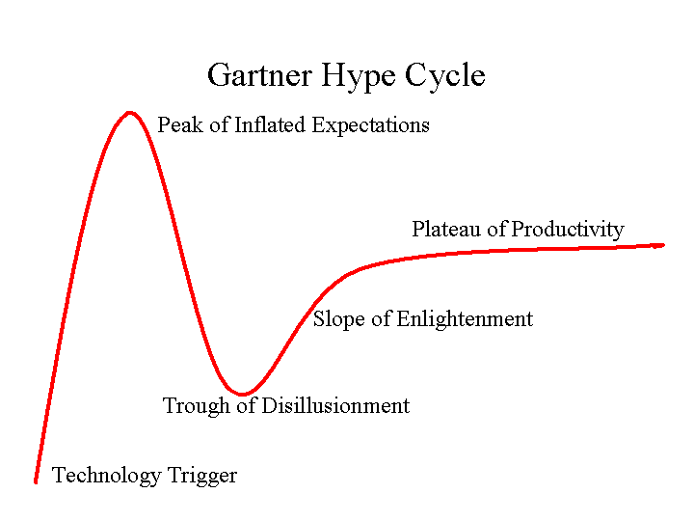
Page <number>

Slide 32
Application Architecture Documentation
Choose the Application Architecture Link from the Developers Index:
https://www.tc2.ford.com/ts/JCOE/Java%20Technologies%20Wiki/Index.aspx
This is a “work in progress”
Page <number>

